Slide 1


Sessions 3 and 4: Income statement
Financial Analysis
BBA FinTech, 2nd year
March 2026
Eric Maton

Slide 2
Sessions 1 and 2
Basic business equation or fundamental accounting equation (balance sheet represented as an equation)
Sessions 3 and 4
Income statement (or P&L: profit and loss account): from accounting information to financial analysis
Brief contents
Session 5 and 6
Non-current assets (P,P&E, intangible assets and right-of-use assets) and current assets (inventories)

Slide 3
Session 7
Financial analysis techniques:
Activity ratios, solvency ratios and liquidity ratios
Brief contents
Sessions 8 and 9
Statement of cash flows (operating cash flows, investing cash flows and financing cash flows) and revision

Slide 4
Grade
10% Midterm exam 1: MCQ on Blackboard at the beginning of session 4 (Tuesday 24 March) (30 minutes) with simple calculator
20% Midterm exam 2: MCQ on Blackboard at the beginning of session 7 (Tuesday 31 March) (1 hour) with simple calculator
10% Attendance
60% Final examination: 3 exercises (2 hours)

Slide 5
Income statement: matching principle and full costing method

Slide 6
P&L or income statement
What’s it for? What’s it not for?
Over a period, are we profitable i.e. selling price higher than unit cost for the quantity sold? Yes operating profit
No operating loss
Profit/(Loss) or Earnings = Revenue (or Income) – Expense
Profit = wealth creation (do we create more value than we consume resources?)
We want the full cost of what we sell (all expenses included in the P&L are related to sales = matching principle i.e. we match expenses against revenue) in order to keep the full cost of what we don’t use or don’t sell in the inventories (balance sheet).
Full costing method: raw material inventory is valued at the full purchasing cost and finished goods inventory is valued at the full production cost

Slide 7
From purchases to the cost of sales in P&L
Components inventory
Components purchases including all cost needed to have components available in inventory
P&L
Sales revenue
Cost of sales
Gross profit
S,G&A expenses
Operating profit
End.
Inv.
Op.
Inv.
Components used for production
bikes inventory
ebikes inventory
Other manufacturing cost
bikes purchases including all cost needed to have bikes available in inventory
Cost of goods manufactured (COGM)
Ending
Inventory
End.
Inv.
Op.
Inv.
bikes used for production
Cost of goods sold (COGS)
Opening
Inventory
Op. inv.: opening inventory, End. Inv.: ending inventory

Slide 8
MCQ n°1: Full costing method
Thin Company has RMB 100,000 of expense in manufacturing 200 products. The commercial and administrative expense amounts to RMB 150,000. Sales volume is 150 products.
The selling price per product without VAT is RMB 1,800.
What is the operating profit calculation with the full costing method?
1. Operating profit = (1,8 – 1) x 150 – 100 = 20 in RMB thousands
2. Operating profit = (1.8 – 1) x 150 + (1.8 – 0.5) x 200 = 380 in RMB thousands
3. Operating profit = (1.8 – 1.5) x 150 = 45 in RMB thousands
4. Operating profit = (1.8 – 1.5) x 200 = 60 in RMB thousands

Slide 9
P&L or income statement
What’s it for? What’s it not for?
Expenses ≠ cash outflow and revenue (or Income) ≠ cash inflow because of credit terms, sales volume ≠ production volume and noncash expenses (for instance, depreciation and amortization expense) and noncashrevenue (for instance, reversal of impairment losses):
Manufacturing or production expenses are adjusted to sales volume in the P&L
Credit terms are not taken into account inside the P&L
Sales are recorded at the date of delivering goods or rendering services (≠ date of cash collection from customers)
Expenses are recorded when the goods or services are sold (marching principle).

Slide 10
Revenue and expense: categories (operating, non-recurring and financial)

Slide 11
Income (IFRS) or revenue (US GAAP)
Income | Revenue or sales revenue or sales or turnover (net) | Operating activity
 | Other operating revenue (royalties, license fees, etc.) | Operating activity
 | Gain on sale of P,P&E and intangible assets | Non-recurring activity
 | Gain on sale of financial assets | Financial activity
 | Other financial income (interest income and dividend income) | Financial activity
Net income (or net profit/(loss)) = Income (or revenue under US GAAP) - Expense

Slide 12
Expense
Expense | Operating expense | Operating activity
 | Loss on sale of P,P&E and intangible assets | Non-recurring activity
 | Loss on sale of financial assets | Financial activity
 | Interest and other financial expense | Financial activity
 | Income (or coporate) tax expense
Net income (or net profit/(loss)) = Income (or revenue under US GAAP) - Expense

Slide 13
Prepaid expense and unearned revenue: when should expense and revenue be recorded?

Slide 14
MCQ n°2: prepaid expense
One insurance is paid at the beginning of February 2025 for one year insurance starting in February 1st 2025. What is the impact of this insurance on assets, liabilities and equity at the end of February 2025 (by comparison with the situation without insurance)?
1. Decrease in assets, increase in liabilities and decrease in equity
2. Decrease in assets, decrease in liabilities and increase in equity
3. Decrease in assets, decrease in liabilities and no change in equity
4. Decrease in assets, decrease in equity and no change in liabilities

Slide 15
MCQ n°3: Unearned or deferred revenue
One annual subscription is sold to a customer at the beginning of February 2025. The subscription starts for the customer at the beginning of February and give right to equal services every month. What is the impact of this annual subscription on assets, liabilities and equity at the end of February 2025 (by comparison with the situation without subscription)?
1. Increase in assets, increase in liabilities and increase in equity
2. Increase in assets, increase in liabilities and no change in equity
3. Increase in assets, increase in equity and no change in liabilities
4. Increase in assets, decrease in liabilities and no change in equity

Slide 16
Revenue or expense = change in equity
Transactions | Assets | Liabilities | Equity (= Net assets)
New debt | + Cash | + debt (or financial liabilities)
Interest due but not already paid |  | + Accrued interest payable | - Interest expense (profit reduction)
Repayment of the debt | - Cash | - Debt (or financial liabilities)
Sale of P,P&E | + Cash (portion of sale price cash received) + Accounts receivable (portion of sale price not cash received) - P,P&E (at net value) |  | + Gain or - Loss (= sale price – Net book value) (in P&L)

Slide 17
Operating expense by nature
P&L or income statement categories

Slide 18
P&L
Sales revenue or turnover
Raw Material expense
Operating expense by nature
Employee expense
Rent expense
Other external services and operating tax
Operating expense by nature
Bad debt expense
Write-down expense
D&A expense
(recurring) operating income

Slide 19
P&L
Sales revenue or turnover
Raw Material expense
Operating expense by nature
Employee expense
Revenue
Rent expense
–
Other external services and operating tax
Operating expense
=
Bad debt expense
(recurring) Operating income
Write-down expense
D&A expense
(recurring) operating income

Slide 20
P&L
Sales revenue or turnover
Raw Material expense
Cash expense and non-cash expense
Employee expense
Cash expense
Rent expense
Other external services and operating tax
+
Operating expense
Bad debt expense
Non-cash expense
Write-down expense
D&A expense
(recurring) operating income

Slide 21
P&L
Sales revenue or turnover
Raw Material expense
EBITDA and EBIT
EBITDA: Earnings Before Interest (expense and income), (income) Tax, Depreciation and Amortization expense
= impact of operating activity (purchasing, production and selling) on P&L without impact of investment decisions on P&L
EBIT: Earnings Before Interest (expense and income) and (income) Tax
Employee expense
Rent expense
Other external services
Bad debt expense
Write-down expense
EBITDA
Impact of current and past investment decisions
D&A expense
(recurring) Operating income

Slide 22
P&L
Sales revenue or turnover
Raw Material expense
Cash expense and non-cash expense
Employee expense
EBITDA: Earnings Before Interest (expense and income), (income) Tax, Depreciation and Amortization expense
= Potential operating cash flow (taking into account some future shortfall (loss of earnings) in inventories sold and collection from customers)
Rent expense
Other external services
Bad debt expense
Write-down expense
EBITDA
D&A expense
(recurring) operating income

Slide 23
P&L
Sales revenue or turnover
Raw Material expense
Cash expense and non-cash expense
Employee expense
EBITDA: Earnings Before Interest (expense and income), (income) Tax, Depreciation and Amortization expense
= Potential operating cash flow
Rent expense
Other external services
Bad debt expense
Why “potential”? Because we are in the P&L, it means we have what is due, consumed, used up by the company and what is due to the company (and not what is paid or received by the company)
Write-down expense
EBITDA
D&A expense
(recurring) operating income

Slide 24
Operating expense by function
P&L or income statement categories

Slide 25
P&L
Sales revenue or turnover
Raw Material expense
Cost of sales
Employee expense
Cost of sales
Rent expense
Operating expenses by function
Other external services
Cost of sales (or cost of revenue):
Cost Of Goods Sold (COGS): in a manufacturing company (i.e. manufacturing cost of products sold)
Cost Of Goods Sold (COGS): in a merchandise company (i.e. purchase cost of merchandise sold)
Direct cost of services rended: in a service company
Bad debt expense
Write-down expense
D&A expense
(recurring) Operating income

Slide 26
P&L
Sales revenue or turnover
Raw Material expense
S,G&A expense
Employee expense
S,G&A: Selling, General and Administrive
All the other operating expenses than COGS. It means commercial, administrative and R&D expenses (expenses directly in function of sales volume)
Rent expense
Other external services
Bad debt expense
Operating expenses by function
S,G&A expense
Write-down expense
D&A expense
(recurring) Operating income

Slide 27
P&L
COGS = manufacturing cost of what is sold = COGM (manufacturing cost of the period) – What is produced during the period but not sold (Ending Finished Goods (FG) inventory) + What is produced during previous periods and sold during the period (Opening FG inventory)
Cost of sales and inventories
Cost of sales
COGS = purchase cost of merchandise sold = Purchase cost of merchandise purchased (purchase cost of the period) – What is purchased during the period but not sold (Ending Finished merchandise inventory) + What is purchased during previous periods and sold during the period (Opening merchandise inventory)
Cost of sales = Cost of goods sold (i.e. manufacturing cost of products sold + cost of merchandise sold) + Direct cost of services rendered

Slide 28
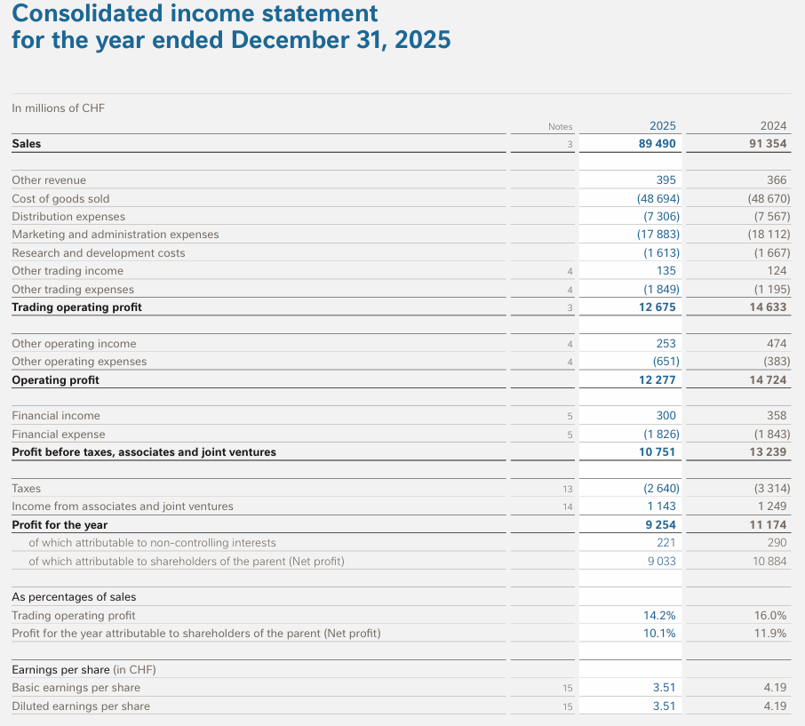

Operating expense by function

Slide 29
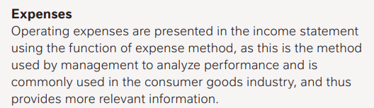
Operating expense by function Example: Nestle

Slide 30
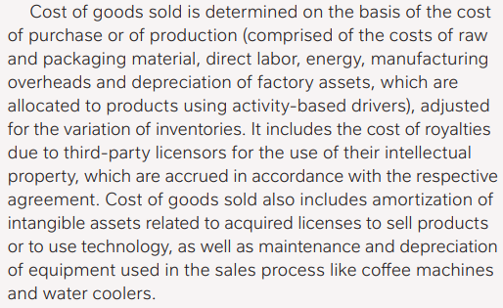

Slide 31
Income statement with operating expense by function
Sales revenue or turnover
Gross profit or gross margin
–
–
Cost of sales
S,G&A expense
=
=
Gross profit or gross margin
Operating income

Slide 32
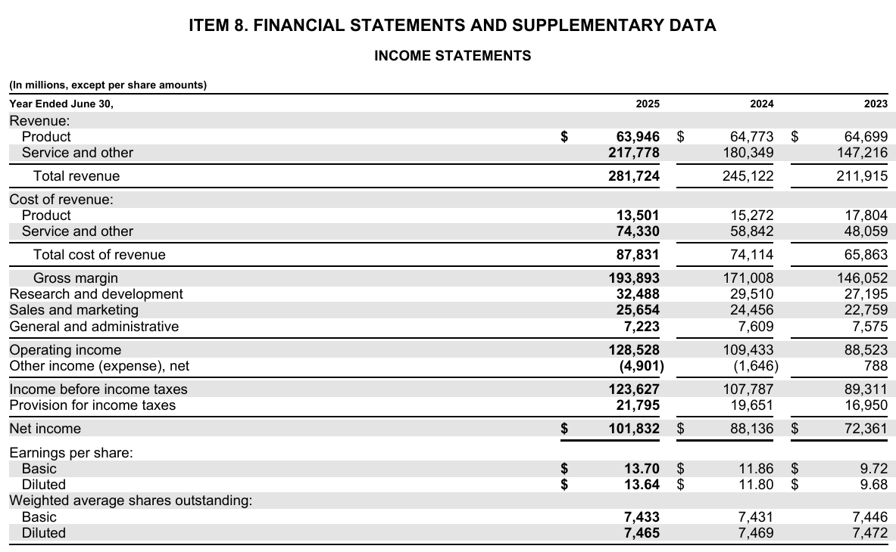
Microsoft (10k 2025)
Operating expense by function

Slide 33
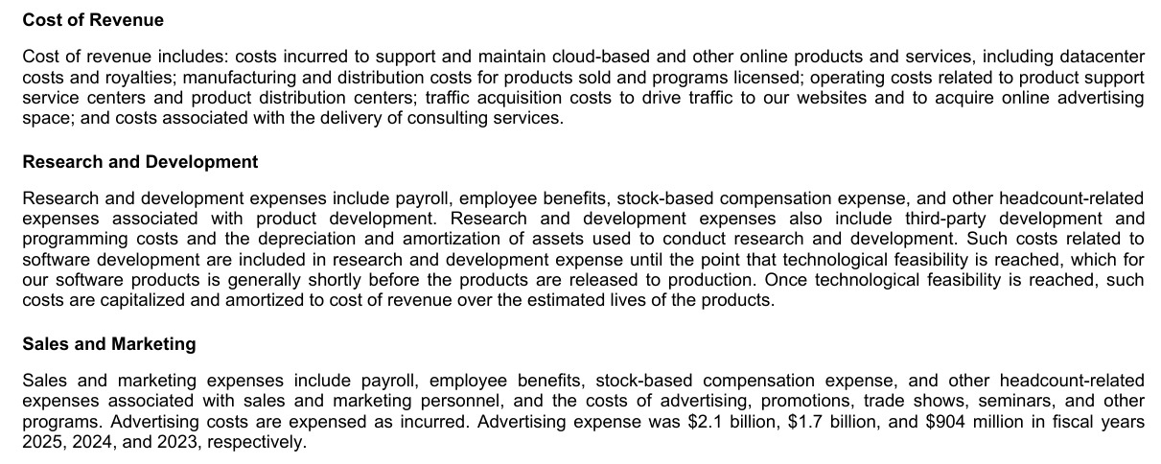
Microsoft (10k 2025)

Slide 34
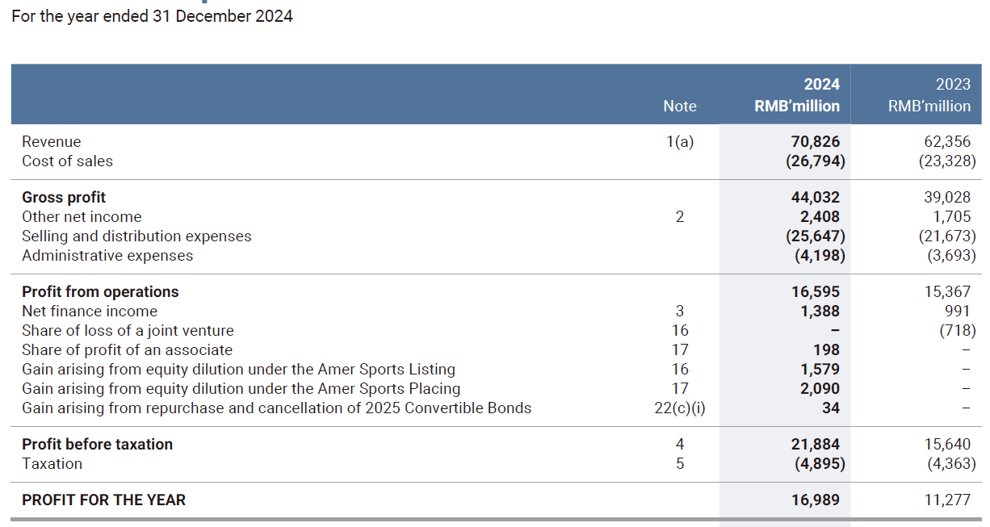
Anta Sports (2024 annual report) Operating expense by function
Total operating expense by function in 2024 = 26,794 + 25,647 + 4,198
= RMB 56,639 million
Total operating expense by function in 2023 = 23,328 + 21,673 + 3,693
= RMB 48,694 million

Slide 35
Alternative income statement presentations
Operating expense by function or by nature

Slide 36
EBIT calculation with operating expense by function and by nature
EBIT calculated with operating expense by function | EBIT calculated with operating expense by nature
Revenue, net - Cost of sales (or cost of revenue) = Gross profit Gross profit - Commercial expense - Administrative expense - R&D expense = Operating profit Operating profit - Non-recurring expense + Non-recurring income = Earnings Before Interest and Taxes (EBIT) | Revenue, net - Components or raw material expense - Employee expense - Rent expense - Other external services expense - Operating taxes = Earnings before Interest, Taxes, Depreciation and Amortization (EBITDA) EBITDA - Depreciation expense = EBITA EBITA - Amortization expense = Operating profit Operating profit - Non-recurring expense + Non-recurring income = Earnings Before Interest and Taxes (EBIT)

Slide 37
Common-size income statement

Slide 38
Common-size income statement All amounts are expressed as a percentage of revenue
Manufacturing company | In % of revenue In 2024 | In % of revenue in 2025
Sales revenue | 100% | 100%
Cost of sales | 80% | 78%
Gross profit | 20% | 22%
Selling, general and administrative expense | 15% | 15%
(recurring) Operating profit | 5% | 7%
Manufacturing company:
Cost of sales = cost of goods sold = production cost of finished goods sold

Slide 39
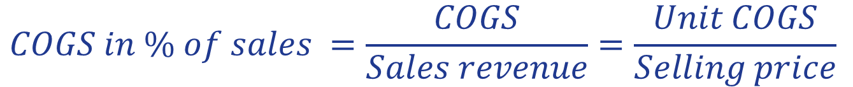
$$COGS in \% of sales =\frac{COGS}{Sales revenue}=\frac{Unit COGS}{Selling price}$$
Alternative explanations of the good performance :
Decrease in unit COGS,
Increase in selling price higher than increase in unit COGS,
Decrease in unit COGS higher than decrease in selling price
Or increase in selling price without change in unit COGS
Alternative interpretations | In % of revenue In 2024 | In % of revenue in 2025
Sales revenue | 100% | 100%
Cost of sales (here, cost of goods sold: COGS) | 80% | 78%
Gross profit | 20% | 22%
S,G&A expense | 15% | 15%
(recurring) Operating profit | 5% | 7%
- 200 points
The sales volume effect is included in the unit COGS through unit manufacturing fixed cost (a decrease in Unit FC = economies of scale) or unit manufacturing variable cost (learning experience or negotiation (for instance, a decrease in purchase price with a better negotiation with suppliers))

Slide 40
Traditionnal EBIT calculation
Calculation from bottom line
Net profit (or EAT: Earnings After Taxes) + Income tax expense = EBT (Earnings before Taxes)
EBT + Interest and other financial expense – Interest and other financial income = EBIT (Earnings Before Interest and Taxes)
EBIT + D&A expense (+ non-recurring expense – Non-recurring income) = EBITDA

Slide 41
3 earnings: earnings from recurring operating activities,earnings from non-recurring activites and earnings from financial activities
P&L or income statement categories

Slide 42
3 main categories in P&L (for continuing operations)
1st category: Operating activity (or recurring activity)
Operating income = Revenue
– Operating expenses (by nature or by function)
Operating expenses by nature = Raw Material cost + Employee cost + Depreciation and amortization (D&A) expense + Purchases not for inventory + Rent expense Other external services + operating taxes …
=
Operating expenses by function = Cost of Goods Sold (COGS or cost of sales) + Selling, General and Administrative (S,G&A) expense

Slide 43
3 main categories in P&L
1st category: Operating activity (or recurring activity)
Operating profit = Sales revenue
– Operating expenses (by nature or by function)
Operating expenses by nature = Raw Material cost + Employee cost + Depreciation and amortization expense + Purchases not for inventory + Rent expense Other external services …
Impact of investing activity on P&L

Slide 44
3 main categories in P&L
1st category: Operating activity (or recurring activity)
Operating profit = Sales revenue
– Operating expenses (by nature or by function)
+
Impact of accumulated investments in financial assets
Cost of the financing by debt (i.e. interest-bearing liabilities)
3rd category: Financial activity
Financial profit = Interest income and other financial income – interest expense and other financial expense

Slide 45
3 main categories in P&L
1st category: Operating activity (or recurring activity)
Operating profit = Sales revenue
– Operating expenses (by nature or by function)
+
2nd category: non-recurring activities or non-operating activities (for instance, divestment, reorganization, reduction in value of business activities)
+ Gains/- losses on disposal of non-current assets
- Restructuring cost
- Impairment/+reversal on impairment losses
+
3rd category: Financial activity
Financial profit = Interest income and other financial income – interest expense and other financial expense

Slide 46
3 main categories in P&L
Operating profit = Sales revenue
– Operating expenses (by nature or by function)
+
+ Gains/- losses on disposal of non-current assets
- Restructuring cost
- Impairment/+reversal on impairment losses
=
Income before (income) tax
+
Financial profit = Interest income and other financial income – interest expense and other financial expense

Slide 47
Operating activity
(daily operations)
Non-recurring activity
Financial activity
Income tax expense
Net income

Slide 48
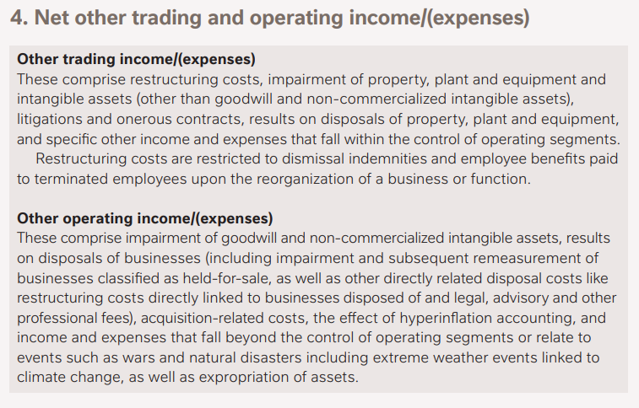
Non-recurring income and expense

Slide 49
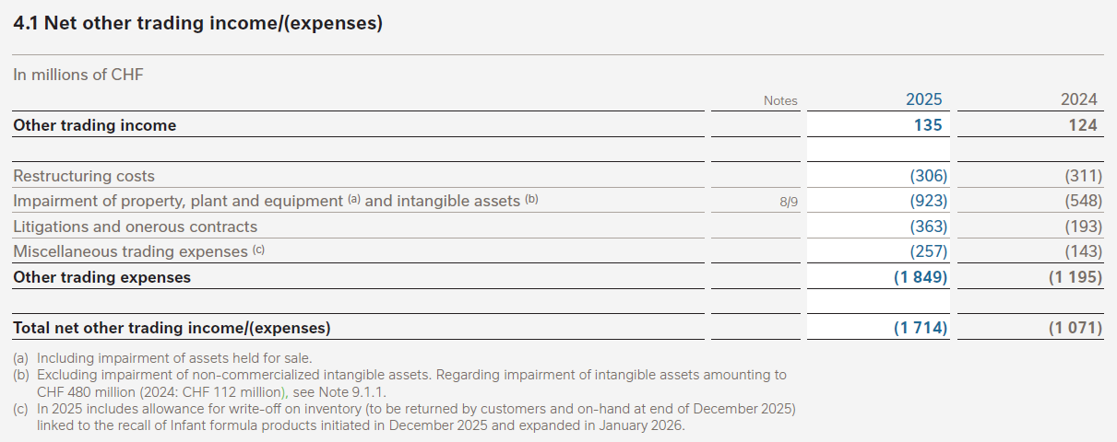
Non-recurring income and expense

Slide 50
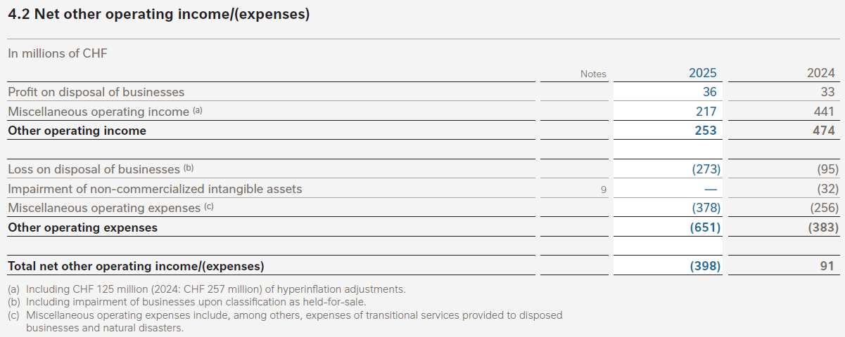
Non-recurring income and expense

Slide 51
Operating activity (or daily operations)
Recurring operating profit or adjusted EBIT
Non-recurring activity
EBIT (Earnings Before Interest (income and expense) and income Tax)
Comment:
Recurring operating profit, operating profit and EBIT are non-GAAP indicators.
Companies can include or exclude the income and expense they want into these indicators.
With the IFRS 18 it will be different (starting date of application in EU: 2028).

Slide 52
Operating activity (or daily operations)
Non-recurring activity
Income from non-operating assets (investments < 20% stake in a company or other financial instruments)
Expense from financing activity by debt
Income from non-operating assets (More than 20% stake in L’Oreal)

Slide 53
From profit before tax to net profit
Accounting profit (means calculated according to accounting rules/principles
Profit before tax
X
Effective tax rate
=
Income before (income) tax
Income tax expense
- Income tax expense
= Net income
The “bottom line”

Slide 54
Income tax expense
Accounting profit (means calculated according to accounting rules/principles
Profit before tax
X
Calculated from taxable profit
Effective tax rate
Current tax
=
+
=
Income tax expense
Deferred tax

Slide 55
MCQ n°7
Because of the purchasing, manufacturing and selling activities, a company has €2 million of expense during the first semester of 2024. During this same period, the company delivers products to customers for a value of €3.2 million.
The company borrows a €5 million loan at the beginning of 2024 with an annual interest rate of 8%.
At the beginning of the semester, the company keeps €0.5 million in cash for operating activity and €1 million in bonds with 5% annual coupon rate.
The company sells during this first semester a machine at €1 million and the net book (or carrying) value at the moment to sell it is €1.2 million.

Slide 56
MCQ n°7
What are the operating profit, the gain or loss on sale of the machine, the financial profit and the profit before tax for the first semester of 2024 (in € million)?
 | Profit before tax | Operating profit | Gain/(loss) on sale of the machine | Financial profit
(a) | 1.325 | 3.2 – 2 + 0.5 | 1 – 1.2 | 0.025 – 0.2
(b) | 1.225 | 3.2 - 2 | 1.2 - 1 | 0.025 – 0.2
(c) | 1.175 | 3.2 – 2 | 1 – 1.2 | 0.2 – 0.025
(d) | 0.825 | 3.2 - 2 | 1 – 1.2 | 0.025 – 0.2
=
+
+
=
+
+
=
+
+
=
+
+

Slide 57
MCQ
P&L or income statement categories

Slide 58
Calculation of the operating profit or EBIT
Financial data for February 2026
Components purchase | €200,000
Opening components inventory | €30,000
Ending components inventory | €70,000
Employee cost | €120,000
Depreciation and amortization expense | €70,000
Purchases of material and supplies not for inventory (electricity, water) | €60,000
Interest expense | €25,000
Increase in finished goods inventory | €100,000
Sales revenue | €360,000
Interest income | €8,000
Non-recurring expense | €0
Non-recurring income | €0
What is EBIT in February 2026?
€(50,000) (b) €(47,000) (c) €33,000 (d) €50,000

Slide 59
From purchases to the cost of sales in P&L
Components inventory
Components purchases including all expenses needed to have components available in inventory
P&L
Sales revenue
Cost of sales
Gross profit
S,G&A expenses
Operating profit
End.
Inv.
Op.
Inv.
Components used for production
bikes inventory
ebikes inventory
Other manufacturing cost
bikes purchases including all expenses needed to have bikes available in inventory
Cost of goods manufactured (COGM)
Ending
Inventory
End.
Inv.
Op.
Inv.
bikes used for production
Cost of goods sold (COGS)
Opening
Inventory
Op. inv.: opening inventory, End. Inv.: ending inventory

Slide 60
P&L with operating expense by nature

Slide 61
Additional information
Create the P&L with expenses by function
 | Manufactu-ring part | S,G&A part
Employee cost | €60,000 | €60,000
Depreciation and amortization | €30,000 | €40,000
Purchases of material and supplies not for inventory (electricity, water) | €40,000 | €20,000

Slide 62
P&L with operating expenses by function

Slide 63
MCQ
Question 1
According to these values what is the most likely sales (revenue) (or turnover):
(a) €54,726,667
(b) €54,860,000
(c) €55,760,000
(d) €55,860,000
Net profit | € 10,200,000
Effective tax rate | 1/3
Interest income | € 120,000
Interest expense | € 320,000
Operating expenses | € 40,260,000

Slide 64
MCQ
Question 2
According to these values what is the most likely S,G&A expense?
Profit before tax | € 4,500,000
Income tax rate | 40%
Interest income | € 320,000
Interest expense | € 120,000
Gross profit | €6,500,000
Revenue | €8,600,000
(a) €1,800,000
(b) €2,000,000
(c) €2,100,000
(d) €2,200,000

Slide 65
MCQ
Question 3
What is the interest expense in year 3?
New loan (i.e. borrowing: financial liability): €6,000,000 at the beginning of the first year
Annual repayment of one fifth at the anniversary date
Interest paid annually at the same date (and due for the finished year)
Annual interest rate = 5%
Duration of the loan = 5 years
(a) €120,000
(b) €180,000
(c) €240,000
(d) € 1,440,000

Slide 66
MCQ
Question 4
3 companies have supposed these assumptions for the same kind of tangible asset:
Which company can maximize more than the others its gain at the end of the year 5 (with the same sale price after 5 years)?
Company A Company B Company C
 | Company A | Company B | Company C
Cost of purchase | €100,000 | €100,000 | €100,000
Method of depreciation | Straight-line method
Residual/salvage value | €30,000 | €40,000 | €50,000
Useful life (in years) | 9 | 8 | 6

Slide 67
MCQ
Question n°5
In function of the data below what is EBITDA?
(a) €135,000 (b) €125,000 (c) €90,000 (d) €80,000
Sales revenue | € 200,000
Gross profit | € 120,000
Total operating expenses | € 110,000
Depreciation and amortization expense | € 45,000
Non-recurring expense | €0
Non-recurring income | €0

Slide 68
MCQ
Question n°6
A company has these amounts during the year 2024:
Raw material purchases €400,000
Opening raw material inventory €120,000
Ending raw material inventory €80,000
Direct labor cost €200,000
Manufacturing overhead €100,000
Selling, general and administrative expense €300,000
Opening Finished goods inventory €100,000
Ending Finished goods inventory €150,000
What is cost of goods sold or cost of sales in 2024?
(a) €650,000 (b) €690,000 (c) €710,000 (d) €1,010,000

Slide 69
Inventory valuation: FIFO, LIFO and WAC
P&L or income statement categories

Slide 70
MCQ n°7
What is the total cost of the merchandise sold under FIFO method?
 | Quantity | Unit Cost (€) | Total cost
Opening merchandise inventory | 100 | 100
Merchandise purchased | 60 | 80
Available inventory*
Merchandise sold
Ending merchandise inventory | 40
€10,800 €11,100 €11,600

